Slide 1

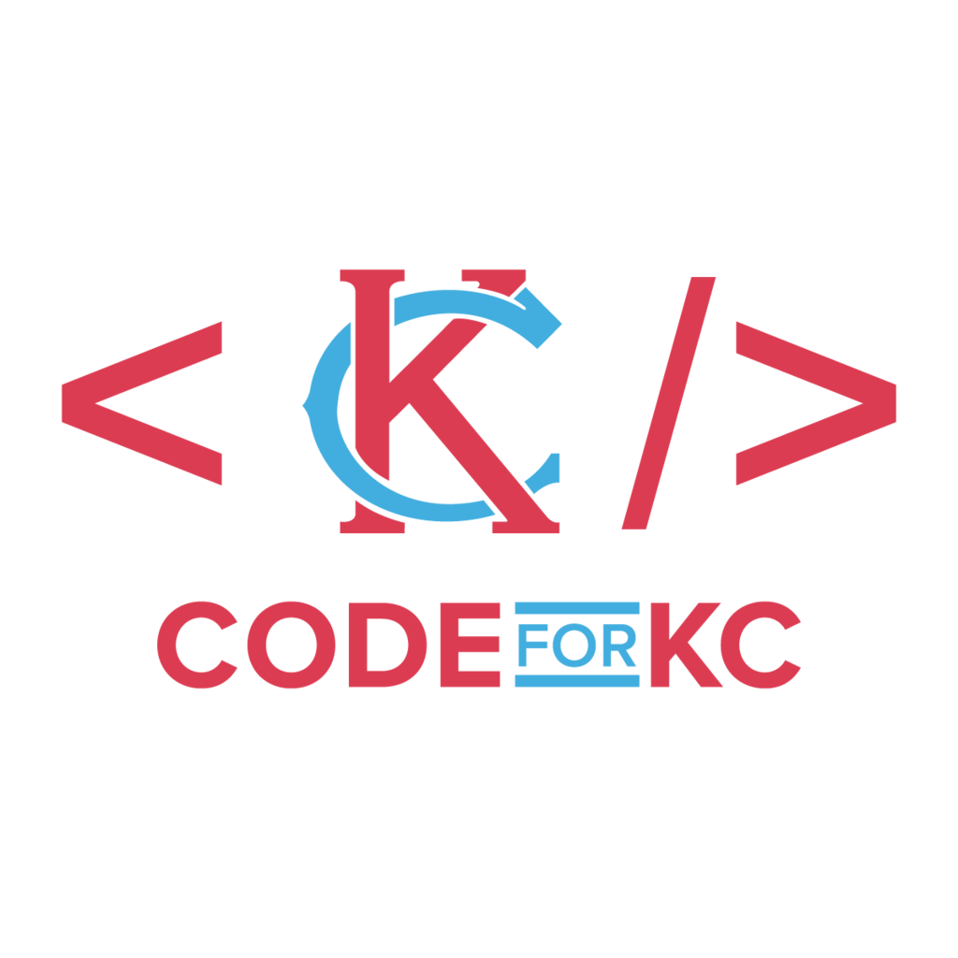
HackKC.org – Hack for Civic Good
Join Code For KC for a hackathon where we tackle and solve community problems
Open source projects; design & code solutions to solve practical problems
Join us for an exciting two day event, September 23rd and 24th
Available projects (so far) on HackKC.org

Slide 2
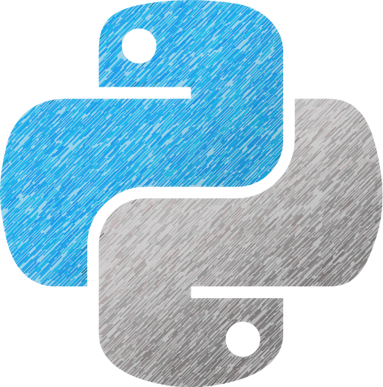
Build a Web App with Django
Slides & Code:
https://github.com/noah-dev/pykc_django_talk

Slide 3

What we will cover
What is a Website Application (Web App)? Why build a Web App?
What tools are available? Why use Python & Django?
Building a basic Todo web app with Django:
Understand Django’s built-in utilities to setup the structure
Setup the Routes, Views, and Model
Create HTML Templates to use, including styling
Process POST requests for user input

Slide 4


Crash Course
We will be hitting these topics quickly at a high level
If you are interested, see resources at end of presentation
Feel free to reach out to me on Slack

Slide 5

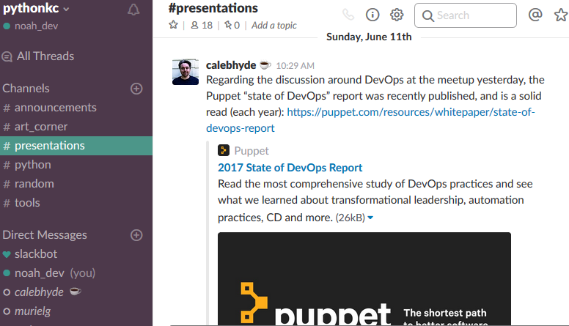
What is a Web App?
Like Slack, Web Apps are:
Accessible with a Browser
Accepts user input
Processes user input
Save to a database
Provide dynamic, user-specific content

Slide 6

Why Build A Web App?
Advantages (Short-list)
Easy to use & share! Only needs a browser
Already cross platform, welcoming OS X, PC, Linux, iOS, Android & more!
Accelerate development with great tools, cloud architecture, and one primary development version!*
Disadvantages (Short-list)
Usually needs internet to start & run app
Need to request user permission for certain features.
* Some features may not be supported on all browsers

Slide 7

What Tools are Available?
Python (Short-list)
Flask – quick turn-around for small apps
Dash – offers great looking front-end for data driven & analytical apps.
Django – offers built-in utilities, boilerplate code & admin panel.
Other Tools (Non-exhaustive)
Ruby on Rails (Ruby), Spring (Java), Play (Scala / Java), NodeJS (JavaScript), ASP.NET (C#), Drupal (CMS), Laravel (PhP), and more

Slide 8
Why use Python & Django?
Why Python?
Python has great syntax. Good code can often be self-documenting
Great community. Many obstacles can be overcome with Google
Why Django?
Offers robust structure that can support small & big apps
Built-in utilities do the heavy lifting, such as Database Migration
Pre-built code, such as Admin panel, provides great features quickly

Slide 9

Front-End & Back-End
Broadly speaking, a web app has a two main parts:
Front-End: What the user sees and is able to interact with
Back-End: What the user cannot see, and does most business logic
Front-End
Back-End
Web Page
What user interacts with
Server Code
Combines user input with other info to deliver result
Database
Store and retrieve data

Slide 10

Prerequisites
You should have some basic experience with:
Python
HTML & CSS
Using terminal commands (CLI)
Make sure to install Django:
pip install django

Slide 11
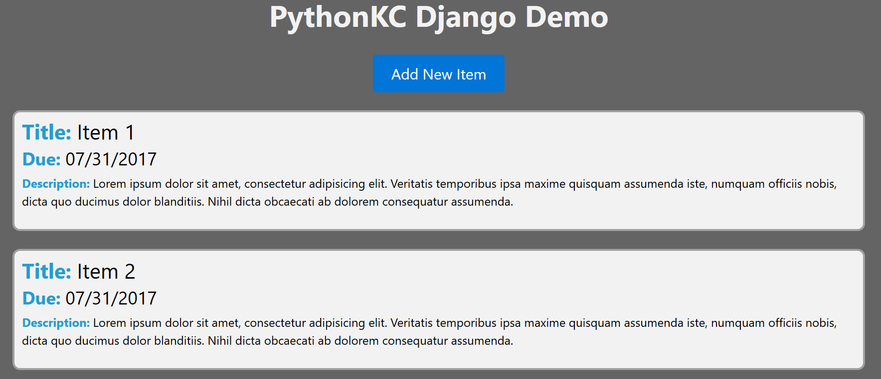
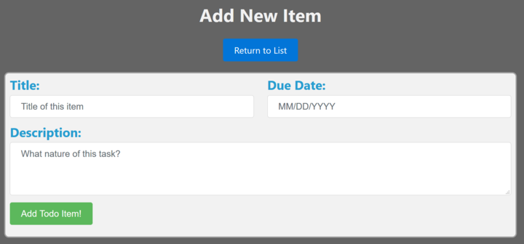
Let’s Build!
Agenda: 5 Steps
Create the structure for app
Basic routes and view in the app
Make model and migrate to the database
Create HTML templates, including styling
Update the view to handle user input

Slide 12

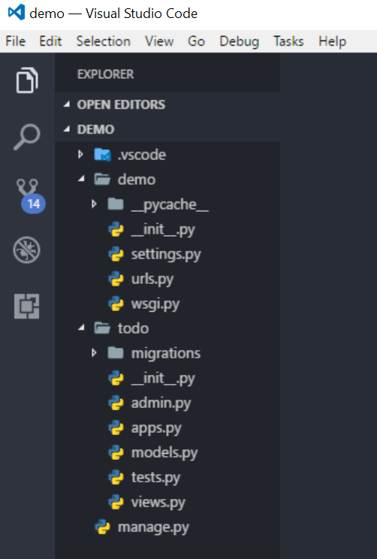
Create the Structure
Create the needed Folders & Files
django-admin startproject demo
python manage.py startapp todo
The demo folder will contain the main project
The todo folder will contain the app, managed by main project.
Run server: python manage.py runserver

Slide 13

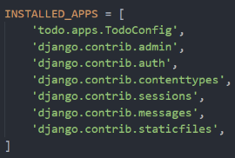
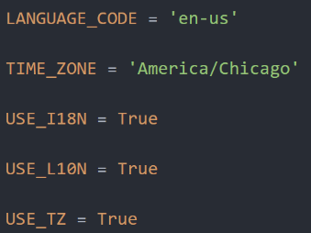
Settings.py
Holds key configurations for the project
Include the todo app within the project
Set time zone to America/Chicago (Central Time)

Slide 14



Routes
Show me page at oursite.com/todo
Which page to load at which URL? Routes!
urls.py in demo and urls.py in todo
Direct requested URL to function in views.py
Call a function to provide HTTP Response
Lookup urls.py in demo
Direct to todo app
Lookup urls.py in todo
Call index() from views.py
Return HTTP response and show Page

Slide 15

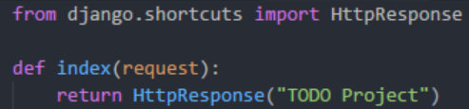
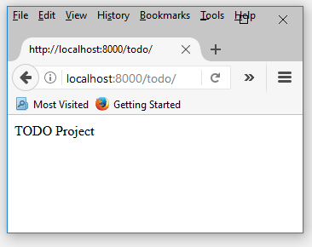
Views
views.py determines content served to user
Returns an HTTP response which is interpreted by the user’s browser
Many different ways to return, ranging from simple text, HTML template, to JSON.
Can also accept user input via GET/POST request

Slide 16

Database – What is a model?
Let’s imagine how the an item would look in our Todo app
How do we represent something like this in the database?
Title | Due | Description
Get Milk | 8/27 | I’m almost out of milk…
Learn new framework | 9/4 | Learn new tools and build….
Prepare for PyKC Talk | 8/25 | Need to prep & practice
Title: Get Milk
Due: 8/27
Description:
I’m almost out of milk. I don’t want to eat cereal with water.

Slide 17
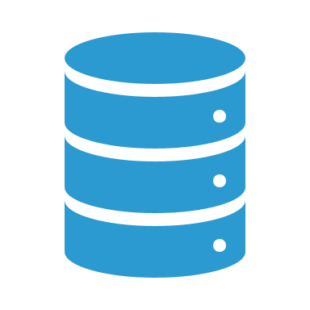
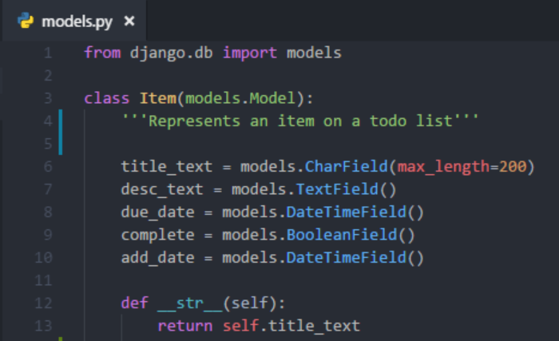
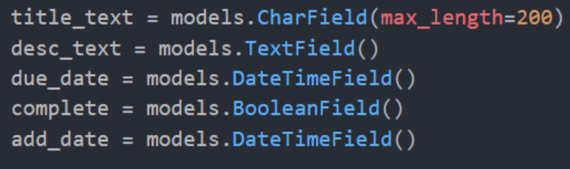
Model
models.py defines the structure, or schema, of table(s) in the database.
Defines how many fields, what kind of fields, and default value.
Also defines methods, like magic methods such as __str__

Slide 18

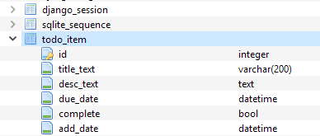
Migrate to Database
Update the database accept new items
python manage.py makemigrations todo
python manage.py migrate
We’ll also create a superuser (admin)
python manage.py createsuperuser
Enter username & password

Slide 19


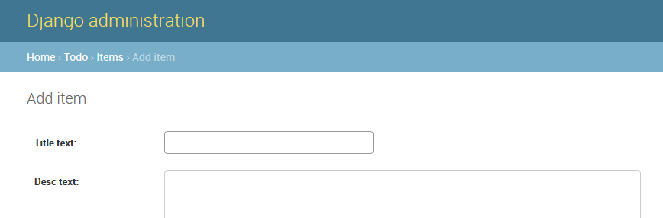
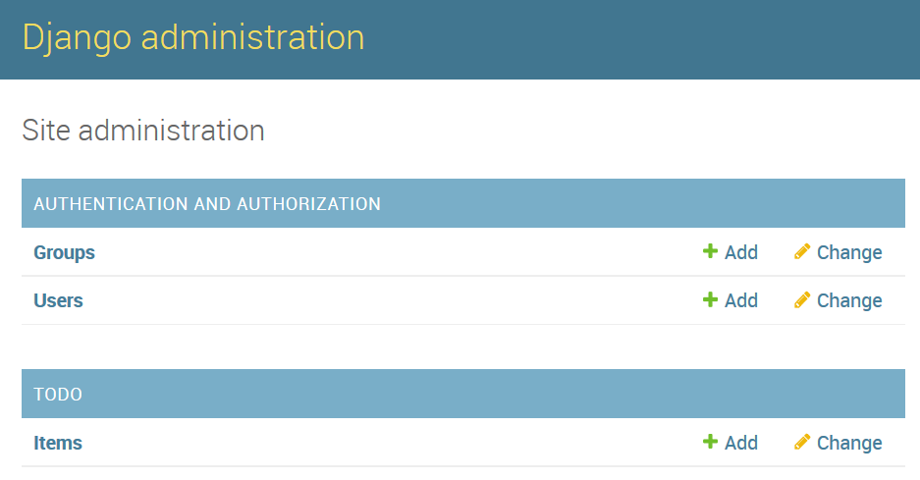
Admin Time!
With the database ready, lets add some items to it
Add code to admin.py to enable in admin view
Using superuser account, log in at localhost:8000/admin

Slide 20
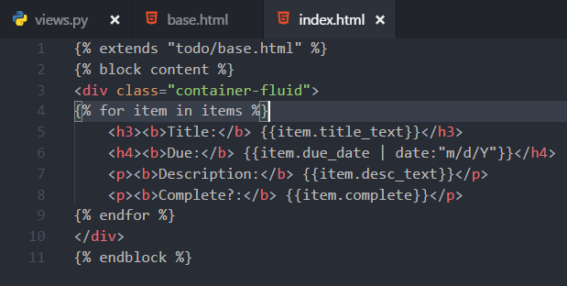
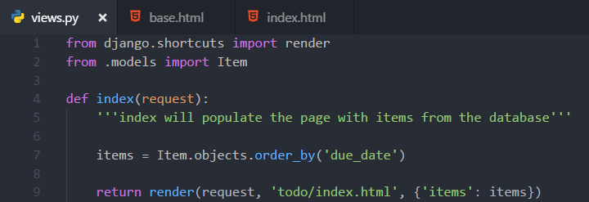
HTML Templates
</>
Lets add some structure with HTML Templates
Double curly braces signify variables (e.g. {{ title }} )
Single curly with percent signify logic (e.g. {% for item in items %} )

Slide 21

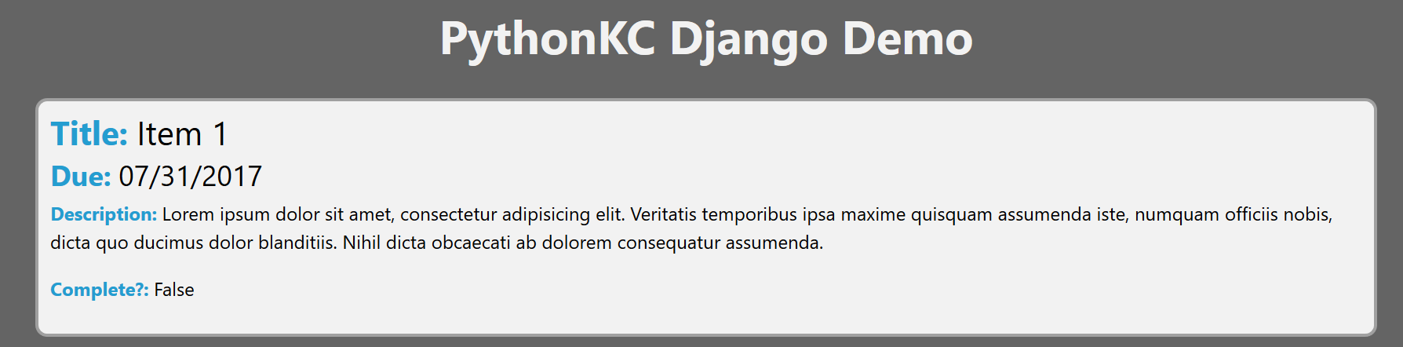
Styling
Let’s add some styling to polish it.
Django stores static assets separate from templates
To add to HTML template, use { % load static % } block

Slide 22

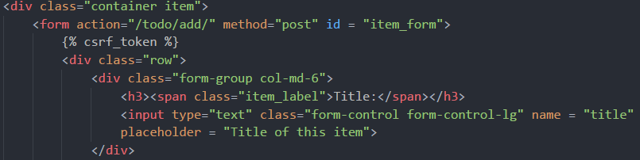
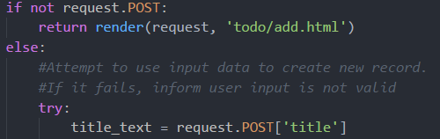
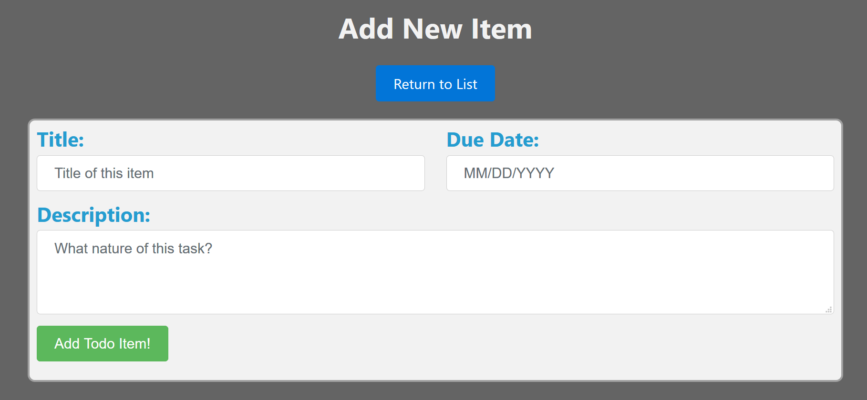
User Input (POST request)
To accept user input, we’ll use an HTTP POST Request
Create a form in HTML template, set to POST
Create code in views.py to accept & process the POST request

Slide 23

Lets Recap
We setup the app using django-admin
We created routes & views to display a basic page
We set a model and which setup the table & fields in the database
We migrated the database, setup the admin, and added items
We setup the view to show the items, and added styling
We enabled user input by adding front-end mark-up & back-end code

Slide 24

Next Steps
Consider taking a look at tutorials and official docs
See resources slide
The “complete” field is practically unused
Add feature to let user mark items as complete
Items can only be displayed
Allow for items to be deleted or modified

Slide 25

Resources (1/2)
Official Django Tutorial
https://docs.djangoproject.com/en/1.11/intro/tutorial01/
Django Girls Tutorial:
https://tutorial.djangogirls.org/en/
YouTube Tutorial By thenewboston
https://www.youtube.com/watch?v=qgGIqRFvFFk&list=PL6gx4Cwl9DGBlmzzFcLgDhKTTfNLfX1IK

Slide 26
Resources (2/2)
Django Docs:
https://docs.djangoproject.com/en/1.11/
Deploying to Heroku
https://devcenter.heroku.com/articles/deploying-python
The slides & the demo’s code:
https://github.com/noah-dev/pykc_django_talk

Slide 27

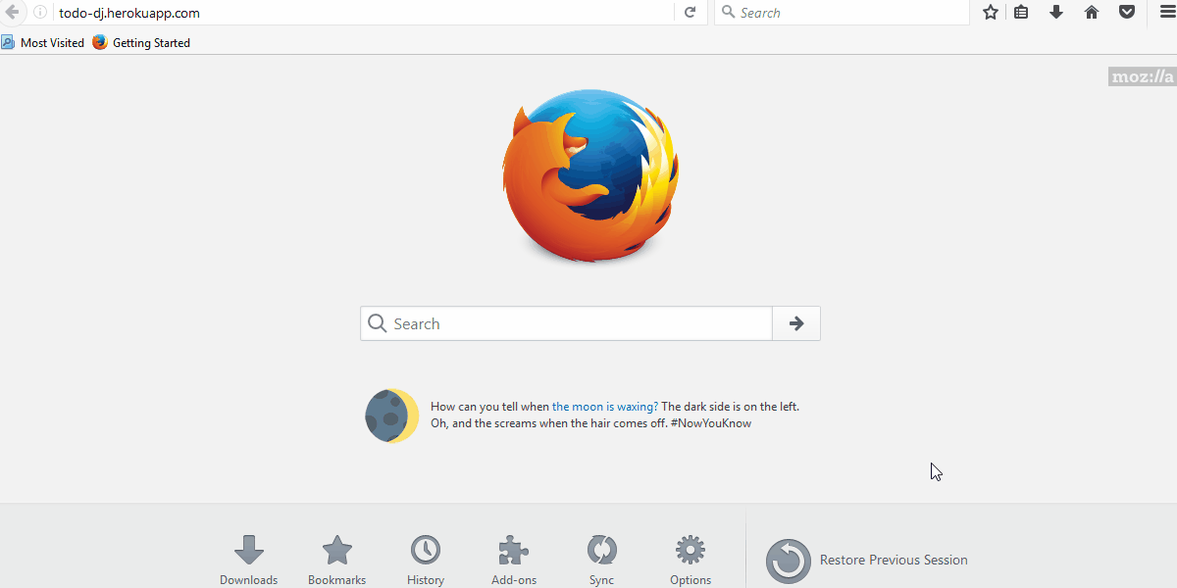
Questions?
Thank you for attending! Have any questions? Fire away!
I’ll be here for the rest of the meetup – please come by

Slide 28
Deploy! To Heroku!
Deploying online will require additional steps. For Heroku:
Setup a python virtualenv (required for Heroku)
Install django-toolbelt module and whitenoise modules
Update settings.py to setup Postgres, static collect, & ENV secret key
Create the a procfile and setup wsgi.py
Create requirements.txt to list dependencies
Push to Heroku repo, build, and migrate database. Deployed!

Slide 29

Setup the Virtualenv
Heroku needs it to retrieve and install the different python modules
Virtualenv creates a specific environment for each project.
For example, use different versions of a module for different projects
Install virtualenv & virtualenvwrapper (virtualenvwrapper-win for windows)
Navigate to project folder and do:
mkvirtualenv django_demo
workon django_demo

Slide 30
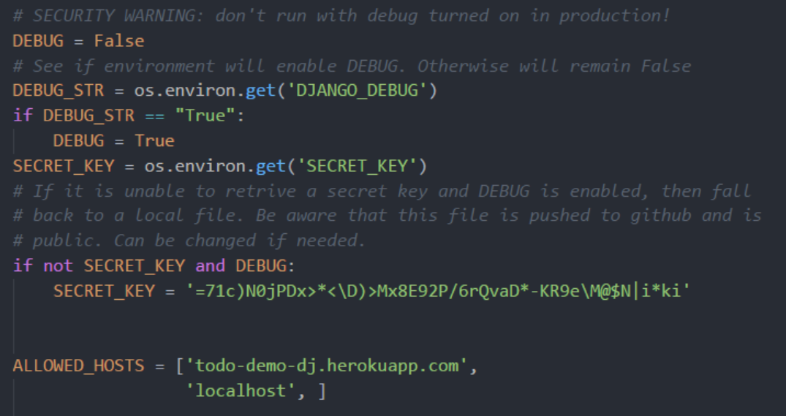
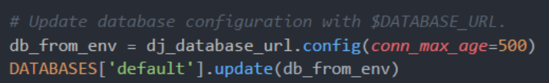
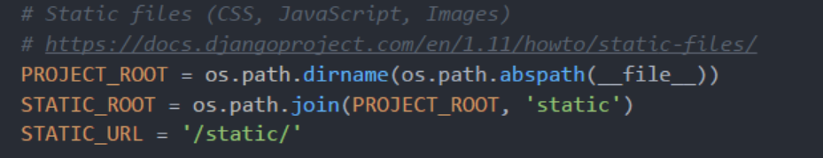
Update settings.py
Update settings to set: secret key, host name, database, & static path

Slide 31

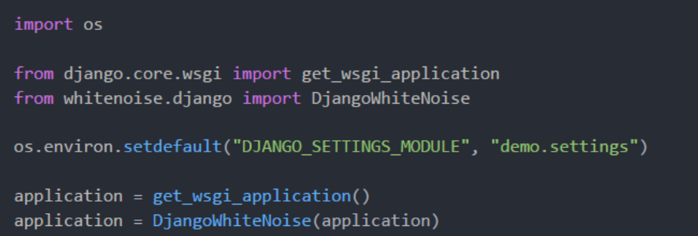
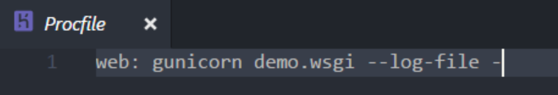
Setup Procfile & wsgi.py
The app will need a WSGI & a static content server
gunicorn is a Web Server Gateway Interface, which enables python code to process incoming HTTP requests concurrently
whitenoise is a module that manages static assets, like images & css

Slide 32

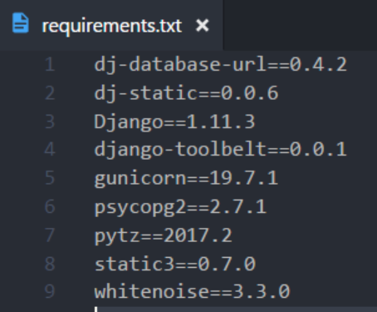
Installed modules – requirements.txt
By now, the following modules should be installed:
pip install django
pip install django-toolbelt
pip install whitenoise
Finally, pip freeze > requirements.txt

Slide 33

Setup the Heroku App
With the changes complete, create a new Heroku App
Setup a free Heroku account, install their CLI, & create an application
Go to settings and add a pair of config vars (click “Reveal Config Vars”)
Set a “DJANGO_DEBUG” to “False”
Set the “SECRET_KEY” to a different secret key
There are a few utilities that can generate new keys. You can use:
import string,random; uni=string.ascii_letters+string.digits+string.punctuation; print(''.join([random.SystemRandom().choice(uni) for i in range(random.randint(45,50))]))

Slide 34

Deploy to Heroku – Push & Migrate
Everything is ready for deployment – let’s ship it!
Set a git remote using the link for the Heroku app
Push to the Heroku repo and wait for it to build
Login using heroku run bash to remote into the server
Run python manage.py migrate
If model is changed, first run python manage.py makemigrations todo
Use exit to leave heroku bash

Slide 35

Complete!
Success – the application is now live!
Visit [app_name].herokuapp.com – or use heroku open
Want to try some more?
Setup a views.py in the project folder to create page at the root url
Update items using AJAX requests without refreshing the page
Add user login with Django’s prebuilt authentication

